Slide 1
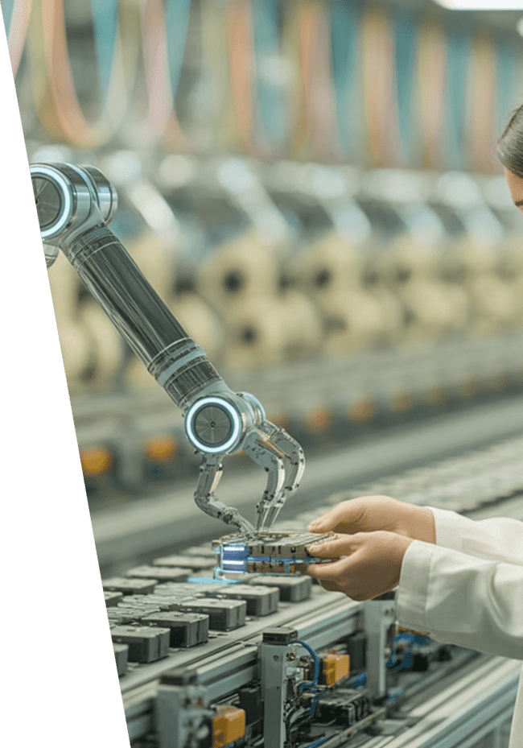
AI in Manufacturing

Slide 2
Title Slide
AI in Manufacturing
Presenter: By Miguel Mora, Hashim Sayed Hoosini, Michael Garcia
Course: ITAI 2372 – Artificial Intelligence Applications
Date: 09 July 2025

Slide 3
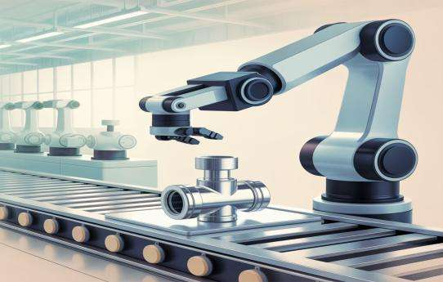
Introduction to AI in Manufacturing
What is AI?
AI (Artificial Intelligence) refers to computer systems that can perform tasks that normally require human intelligence, like learning, decision-making, or recognizing patterns.
AI in Manufacturing
AI in Manufacturing means using smart systems to improve production, detect problems, and make decisions.
It includes machines that can see, learn from data, and automate complex tasks.

Slide 4
Domain Overview & Importance
Manufacturing Process
Economic Impact
Industry Challenges
Manufacturing is the process of creating products using machinery, tools, and labor.
It plays a vital role in the global economy by producing goods at scale.
Challenges include high labor costs, human error, machine downtime, and demand for faster production.

Slide 5
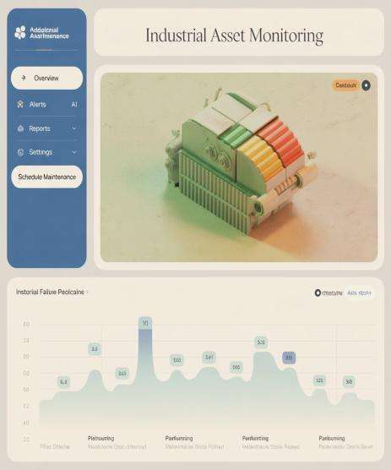
AI Use Case Motivation
AI helps solve problems like:
Equipment breakdowns
Inconsistent product quality
Wasted materials
Example: Using AI to monitor machine performance and predict failures before they happen

Slide 6




AI Techniques Used in Manufacturing
Computer Vision
Predictive Maintenance
For inspecting parts and detecting defects
AI predicts when machines need repair
Robotic Process Automation (RPA)
Digital Twins
Robots perform repetitive tasks
Simulations of factory operations to test changes

Slide 7

Case Study 1 – BMW Group
Computer Vision Implementation
BMW uses computer vision to check if every part is installed correctly.
AI Image Processing
AI scans thousands of images and flags mistakes.
Quality Improvement
This reduces human error and increases assembly line accuracy.

Slide 8
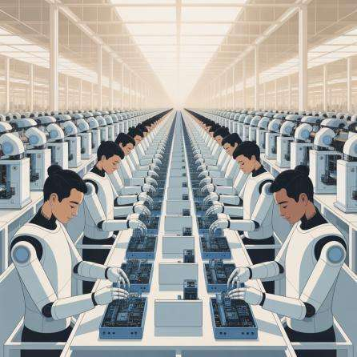
Case Study 2 – Foxconn (Apple Supplier)
AI-Powered Robotics
Foxconn uses AI-powered robots to assemble parts.
Human-Robot Collaboration
Robots work alongside humans to improve speed and precision.
Production Optimization
AI helps schedule production and reduces idle time.

Slide 9
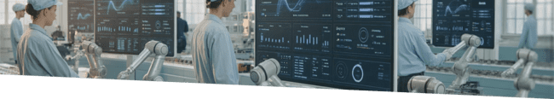
Impact & Benefits
Faster Production
Improved Safety
Machines work without breaks
Dangerous tasks done by robots
Higher Quality
Better Planning
AI catches defects early
Real-time data helps manage supply chains

Slide 10




Challenges & Risks
Technical Errors
Job Displacement
AI can misclassify or fail.
AI systems can produce errors if data is inaccurate
Machines now do some tasks.
Automation may replace some jobs, requiring workforce retraining.
Training
Data Dependence
Workers must learn to work with AI systems
AI relies on accurate and up-to-date data.
AI success depends on updated, high-quality factory data.

Slide 11




Future Directions
Collaborative Robots (Cobots)
Edge AI
Sustainable Manufacturing
AI robots working safely with people
Real-time decisions on the factory floor
AI reduces waste and energy use
Self-Healing Machines
AI predicts and fixes issues automatically

Slide 12

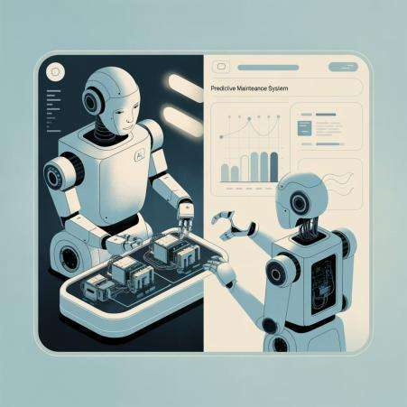
Interactive Slide
This is a flexible slide for a visual or interactive element to enhance the presentation.

Slide 13
Conclusion
1
Smart
2
Safe
3
Fast
AI transforms manufacturing by making it smarter, safer, and faster
Helps solve real problems like breakdowns and defects
Future factories will combine human creativity with machine intelligence
This slide summarizes the main points and offers a final takeaway message.

Slide 14
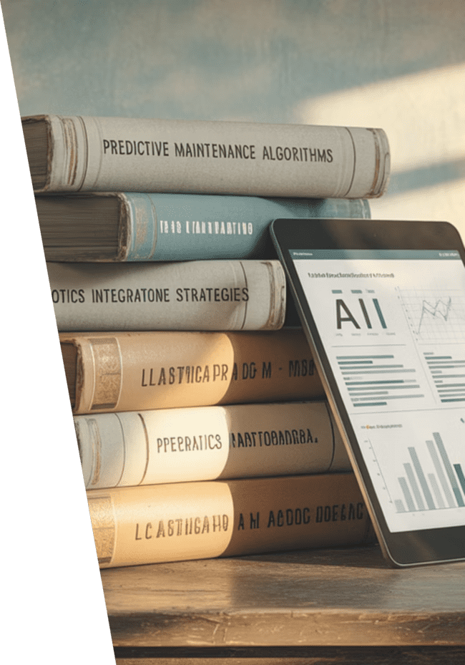
References
BMW Group. (2024). AI in Automotive Production. Retrieved from https://www.bmwgroup.com
Foxconn Technology. (2023). Smart Factory Systems. Retrieved from https://www.foxconn.com
AI in Manufacturing Report. (2023). McKinsey & Company.
World Economic Forum. (2023). The Future of Advanced Manufacturing

